Slide 1

ONLINE COMPANY EXPENSE RECORDING WEBSITE BASED ON MULTI-COMPANY
Brevalda Resnu Putra Kaltanda
218180412
S1 – system information and bussiness

Slide 2
What Is Multi Company ?

Slide 3
What is Multi Company?
A multi-company is a company that owns two or more other companies. Generally, this type of company operates in different industries and has one parent company, referred to as a holding company. A multi-company also has different locations.

Slide 4
What is Multi Company?
A multi-company also a type of company that owns and operates more than one legally separate business entity under a single ownership. In this context, 'company' refers to a legal entity engaged in commercial activities

Slide 5
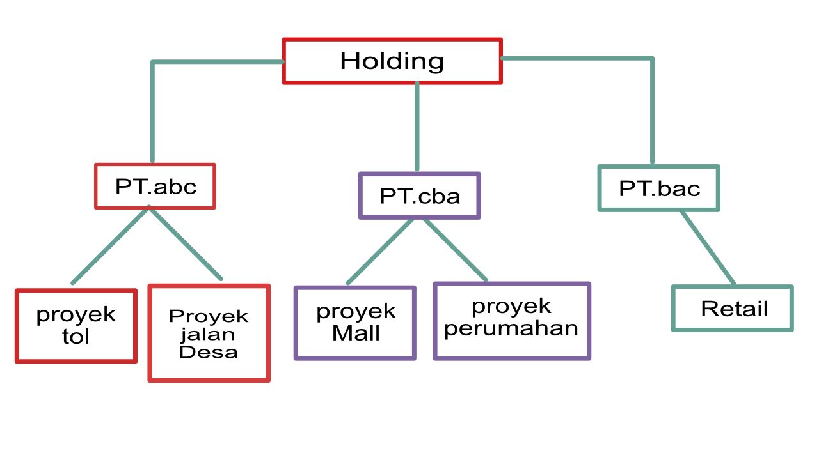

Slide 6
What’s The benefit ?

Slide 7
Benefit
Risk Diversification
By owning several companies operating in different sectors, business risks can be more diversified. If one company experiences a performance decline, the businesses in other sectors can continue to perform well and balance the overall performance.

Slide 8
Benefit
Operational Efficiency
A holding company can help improve efficiency by centralizing certain functions, such as accounting, finance, marketing, and human resources. This can reduce operational costs and enhance synergy between companies within the group.

Slide 9
Benefit
Better Asset Management
A holding company enables more centralized management of assets, which helps optimize the use of resources across all owned companies. It also allows for more efficient distribution of resources among the business entities.

Slide 10
Benefit
Better Control
As a parent company, a holding has strategic control over the various companies it owns, including in key decision-making. This allows the holding to implement cohesive long-term strategies across all its companies.

Slide 11
But there is problems

Slide 12
Problems
these type of business relationships are often overshadowed by trust issues, particularly concerning financial aspects, Especially their expenses.

Slide 13
Problems
Trust issues in the context of finance between these companies can affect the stability, growth, and sustainability of their business collaborations.

Slide 14
What are examples of expenses that can cause trust issues in a multi-company?

Slide 15
Expenses
- employee salaries
- project operational costs
- Miscellaneous expense (repair, natural disasters etc)
- Personal Expenses for the company executive

Slide 16
Solutions?

Slide 17
Solutions
We need a website that has 3 roles, namely a transaction recorder, an approver, and an admin. A transaction recorder is a user who inputs transaction data on the website, an approver is the audit team that monitors the transactions, and an admin is a user who can register new data to be used by other users or register new companies.

Slide 18
Solutions
We need a website that can record various types of entries such as employee salaries, miscellaneous expenses, personal expenses, and project operational costs that can have budget limits.

Slide 19
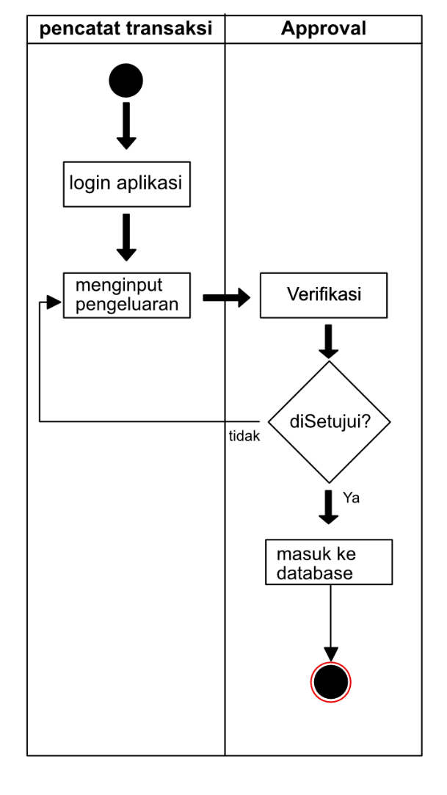

Slide 20
Business plan

Slide 21
SWOT analysis
Opportunities | Threads | Strengths | Weakness
There are not many similar websites yet. | Since it is web-based, it will be vulnerable to attacks by hackers. | Can be accessed across multiple platforms. | The website appears to be a bit complicated due to the numerous and complex features.
 |  | Can be accessed anywhere

Slide 22
One time Cost
Name | Subtotal
Website cost | Rp30.000.000
Hosting and domain cost | Rp709.000
Total | Rp30.709.000

Slide 23
Recurring Cost
 | Keterangan | Subtotal
1 | Hosting Cost per year | Rp 600.000
2 | Domain Cost | Rp 109.000
3 | Maintainance Cost | Rp 1.000.000
 | Total | Rp 1.709.000

Slide 24
Projected Income
 | Fee | Subtotal
1 | Subscription fee per year | Rp 20.000.000
2 | Maintainance fee | Rp 1.000.000
 | Total | Rp 21.709.000

Slide 25
comparison
 | My website | Accurate 5 | Microsoft dynamics nav
scalability | Yes | No | Yes
Cloud storage | Yes | No | Yes
Multi platform | Yes | No | No
Price | 20 million per year | 35 million / 5 license | 31.2million / year

Slide 26
Thank you
Brevalda Resnu Putra Kaltanda
218180412
S1 – system information and bussiness

